Slide 1

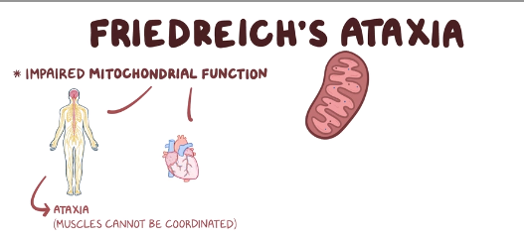
Friedreich’s ataxia panel
Introduction
Friedreich’s ataxia (FRDA) is a genetic, progressive, neurodegenerative movement disorder, with a typical age of onset between 10 and 15 years.
About 25 percent of people with Friedreich ataxia have an atypical form in which signs and symptoms begin after age 25.
Affected individuals who develop Friedreich ataxia between ages 26 and 39 are considered to have late-onset Friedreich ataxia (LOFA).
When the signs and symptoms begin after age 40 the condition is called very late-onset Friedreich ataxia (VLOFA).

Slide 2
Friedreich’s ataxia panel
Clinical manifestation /Symptoms
The first neurological symptom to appear is usually difficulty walking and poor balance (gait ataxia, often described as appearing dizzy or even drunk).
Another early sign of the disease is slowness and slurring of speech (dysarthria). With time speech becomes hesitant and jerky (often referred to as “scanning of speech”).
Most affected individuals also develop difficulty swallowing, due to difficulty coordinating the muscles of the tongue and throat.

Slide 3
Friedreich’s ataxia panel
Clinical manifestation /Symptoms
Difficulty walking
Muscle weakness
Speech problems
Involuntary eye movements
Scoliosis (curving of the spine to one side)
Heart palpitations, from the heart disease which can happen along with Friedreich's ataxia

Slide 4
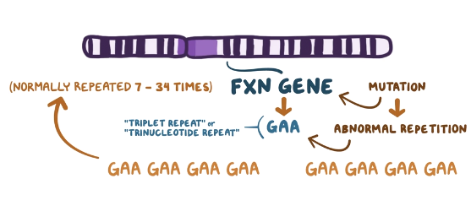
Friedreich’s ataxia panel
Causes
The gene responsible for FRDA has been designated FXN. The FXN gene codes for frataxin, a protein that is required for proper functioning of mitochondria, which are the energy producing parts of our cells.
While the majority of people with FRDA have the expanded GAA repeat mutation in both copies of the FXN gene, a few (<5-10%) have the expanded GAA repeat mutation on one copy of the FXN gene and another type of abnormality (mutation) in the other FXN gene copy.

Slide 5
Comprehensive SCA Repeat panel
Inheritance Pattern
FRDA is inherited as an autosomal recessive condition. Recessive genetic disorders occur when an individual inherits two copies of an abnormal gene for the same condition, one from each parent. If an individual receives one normal gene and one gene for the disease, the person will be a carrier for the disease and will not show symptoms. The risk for two carrier parents to both pass the defective gene and have an affected child is 25% with each pregnancy. The chance of having a child who is an unaffected carrier like the parents is 50% with each pregnancy. The chance for a child to receive normal genes from both parents and be genetically normal for that particular condition is 25%. The risk is the same for both males and females.

Slide 6
Friedreich’s ataxia panel
Gene Panel
FXN,
No of Genes : 1
Sample Type : EDTA-blood sample - 4 ml
TAT : 6 Weeks
Methodology : NGS

Slide 7
Diagnostic Tests

Slide 9
Management

Slide 10
Friedreich’s ataxia panel
Reference
https://www.ninds.nih.gov/disorders/patient-caregiver-education/fact-sheets/friedreichs-ataxia-fact-sheet
https://ghr.nlm.nih.gov/condition/friedreich-ataxia
https://medlineplus.gov/friedreichsataxia.html

